Slide 1
Joins
C393: Database Systems

Slide 2
Review

Slide 3
Lesson Objectives
Utilize joins to select the appropriate data for a problem
Apply Union, Intersect, and Except to join or limit queries.

Slide 4
Joins

Slide 5
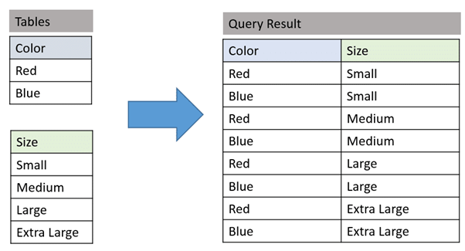
Cartesian Products

Slide 6
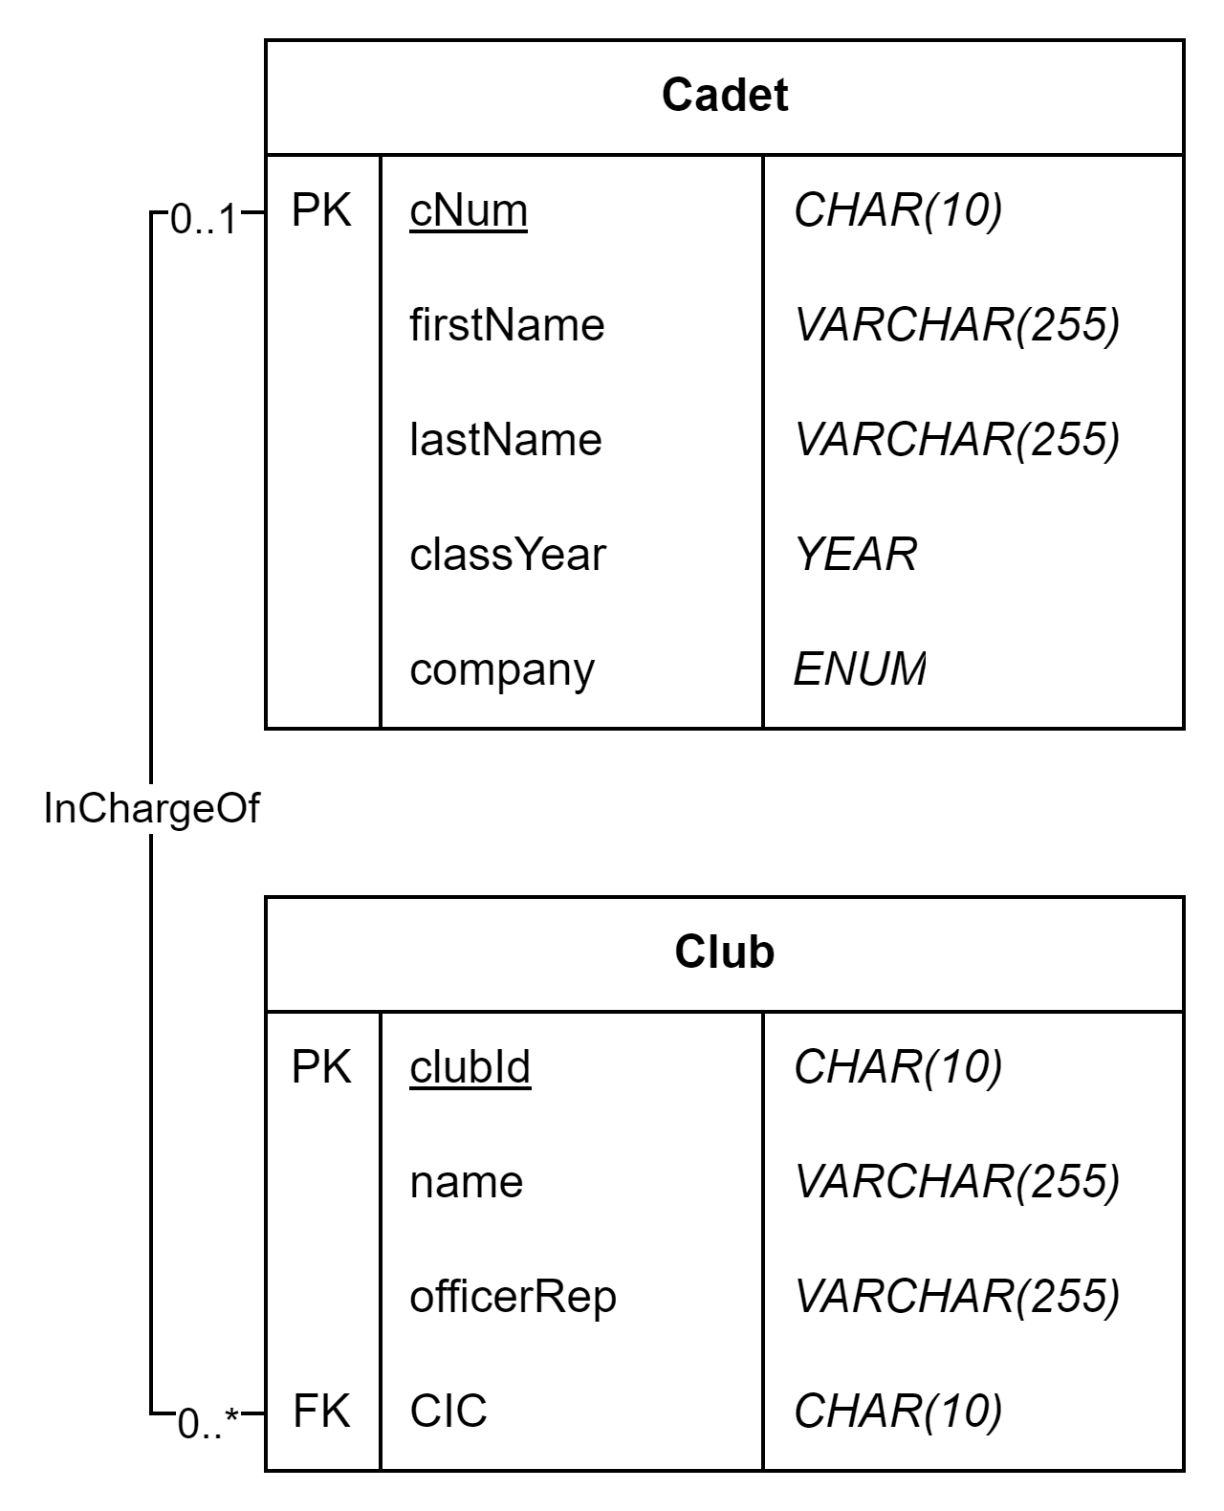
Cartesian Products
cNum | first | last | year | company |  | clubId | name | OR | CIC
133 | John | Smith | 2028 | A |  | 1 | Glee | Shafer | 133
255 | Jane | Doe | 2027 | B |  | 2 | Tennis | Johnson | 255
SELECT *
FROM Cadet, Club
cNum | first | last | year | company | clubId | name | OR | CIC
133 | John | Smith | 2028 | A | 1 | Glee | Shafer | 133
133 | John | Smith | 2028 | A | 2 | Tennis | Johnson | 255
255 | Jane | Doe | 2027 | B | 1 | Glee | Shafer | 133
255 | Jane | Doe | 2027 | B | 2 | Tennis | Johnson | 255
Notes:
How could we use our existing tools to make this a useful query?

Slide 7
Inner Join w/WHERE
cNum | first | last | year | company |  | clubId | name | OR | CIC
133 | John | Smith | 2028 | A |  | 1 | Glee | Shafer | 133
255 | Jane | Doe | 2027 | B |  | 2 | Tennis | Johnson | 255
SELECT *
FROM Cadet, Club
WHERE Cadet.cNum = Club.CIC
cNum | first | last | year | company | clubId | name | OR | CIC
133 | John | Smith | 2028 | A | 1 | Glee | Shafer | 133
255 | Jane | Doe | 2027 | B | 2 | Tennis | Johnson | 255

Slide 8
Inner Join
cNum | first | last | year | company |  | clubId | name | OR | CIC
133 | John | Smith | 2028 | A |  | 1 | Glee | Shafer | 133
255 | Jane | Doe | 2027 | B |  | 2 | Tennis | Johnson | 255
SELECT *
FROM Cadet
INNER JOIN Club
ON Cadet.cNum = Club.CIC
cNum | first | last | year | company | clubId | name | OR | CIC
133 | John | Smith | 2028 | A | 1 | Glee | Shafer | 133
255 | Jane | Doe | 2027 | B | 2 | Tennis | Johnson | 255
Notes:
Functionally, there is no difference between the two.
however, it is nice to keep the filtering criteria separate from the joining criteria

Slide 9
Try it out
Download cadet_joins from Canvas.
Run the queries and inspect the results. Does it match what you learned?

Slide 10
Outer Joins
cNum | first | last | year | company |  | clubId | name | OR | CIC
133 | John | Smith | 2028 | A |  | 1 | Glee | Shafer | 133
255 | Jane | Doe | 2027 | B |  | 2 | Tennis | Johnson | 255
466 | Mike | Johnson | 2026 | C |  | 3 | Track | Haskins | 799
SELECT *
FROM Cadet
LEFT JOIN Club
ON Cadet.cNum = Club.CIC
cNum | first | last | year | company | clubId | name | OR | CIC
133 | John | Smith | 2028 | A | 1 | Glee | Shafer | 133
255 | Jane | Doe | 2027 | B | 2 | Tennis | Johnson | 255
466 | Mike | Johnson | 2026 | C

Slide 11
Outer Joins
cNum | first | last | year | company |  | clubId | name | OR | CIC
133 | John | Smith | 2028 | A |  | 1 | Glee | Shafer | 133
255 | Jane | Doe | 2027 | B |  | 2 | Tennis | Johnson | 255
466 | Mike | Johnson | 2026 | C |  | 3 | Track | Haskins | 799
789 | John | Jackson | 2029 | C |  |  |  |  | 789
SELECT *
FROM Cadet
RIGHT JOIN Club
ON Cadet.cNum = Club.CIC
cNum | first | last | Year | company | clubId | name | OR | CIC
133 | John | Smith | 2028 | A | 1 | Glee | Shafer | 133
255 | Jane | Doe | 2027 | B | 2 | Tennis | Johnson | 255
 |  |  |  |  | 3 | Track | Haskins | 799
789 | John | Jackson | 2029 | C | 1 | Glee | Shafer | 133

Slide 12
Cross Joins
cNum | first | last | year | company |  | clubId | name | OR | CIC
133 | John | Smith | 2028 | A |  | 1 | Glee | Shafer | 133
255 | Jane | Doe | 2027 | B |  | 2 | Tennis | Johnson | 255
466 | Mike | Johnson | 2026 | C |  | 3 | Track | Haskins | 799
?
cNum | first | last | year | company | clubId | name | OR | CIC
133 | John | Smith | 2028 | A | 1 | Glee | Shafer | 133
255 | Jane | Doe | 2027 | B | 2 | Tennis | Johnson | 255
 |  |  |  |  | 3 | Track | Haskins | 799
466 | Mike | Johnson | 2026 | C
Notes:
Stay tuned for more.

Slide 13
Try it out
Run the last two queries and inspect the results. Does it match what you learned?

Slide 14
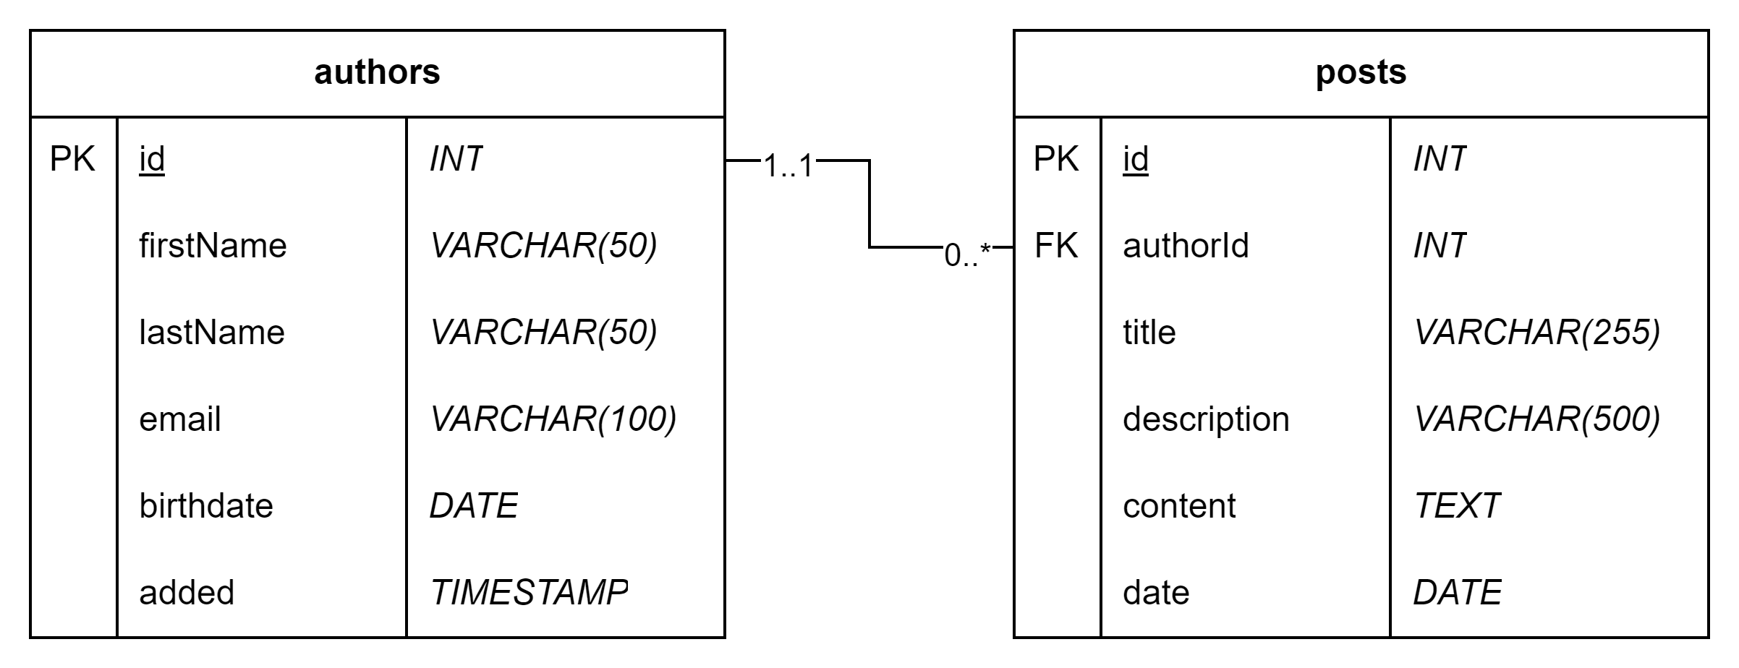
In Class Exercise
Download/import the blog.sql database
Solve the queries in blog_joins.mysqlnotebook (stop where it says stop!)

Slide 15
UNION, EXCEPT, INTERSECT

Slide 16
Multiple queries
We can combine multiple queries using the following statements
UNION: both queries combined (set addition)
INTERSECT: only the matching rows of both queries (set intersection)
EXCEPT: the rows of the first query that are not present in the second query (set subtraction)
Will always exclude duplicates unless you use the ALL operator:
UNION ALL, INTERSECT ALL, EXCEPT ALL

Slide 17

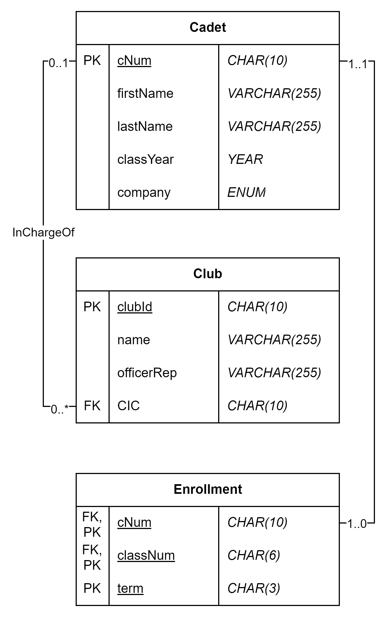
UNION
SELECT ccNum
FROM Cadet AS c
INNER JOIN Club AS cl
ON c.cNum = cl.CIC
UNION [ALL]
SELECT c.cNum
FROM Cadet AS c
INNER JOIN Enrollment AS e
ON c.cNum = e.cNum
List all Cadets taking a class or in a club

Slide 18
INTERSECT
SELECT c.cNum
FROM Cadet AS c
INNER JOIN Club AS cl
ON c.cNum = cl.CIC
INTERSECT [ALL]
SELECT c.cNum
FROM Cadet AS c
INNER JOIN Enrollment AS e
ON c.cNum = e.cNum
Which Cadets are in a Club and also taking a class?

Slide 19
EXCEPT
SELECT c.cNum
FROM Cadet AS c
INNER JOIN Enrollment AS e
ON c.cNum = e.CIC
EXCEPT [ALL]
SELECT c.cNum
FROM Cadet AS c
INNER JOIN Club AS cl
ON c.cNum = cl.cNum
List Cadets in courses unless they’re in a club.

Slide 20
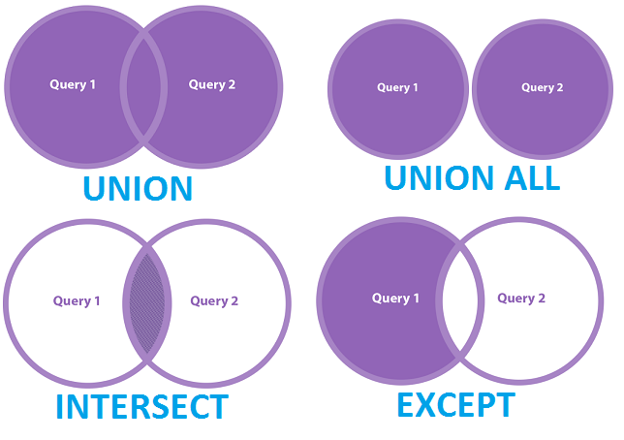
Pictures

Slide 21
Cross Joins
cNum | first | last | year | company |  | clubId | name | OR | CIC
133 | John | Smith | 2028 | A |  | 1 | Glee | Shafer | 133
255 | Jane | Doe | 2027 | B |  | 2 | Tennis | Johnson | 255
466 | Mike | Johnson | 2026 | C |  | 3 | Track | Haskins | 799
?
cNum | first | last | year | company | clubId | name | OR | CIC
133 | John | Smith | 2028 | A | 1 | Glee | Shafer | 133
255 | Jane | Doe | 2027 | B | 2 | Tennis | Johnson | 255
 |  |  |  |  | 3 | Track | Haskins | 799
466 | Mike | Johnson | 2026 | C
Notes:
Stay tuned for more.

Slide 22
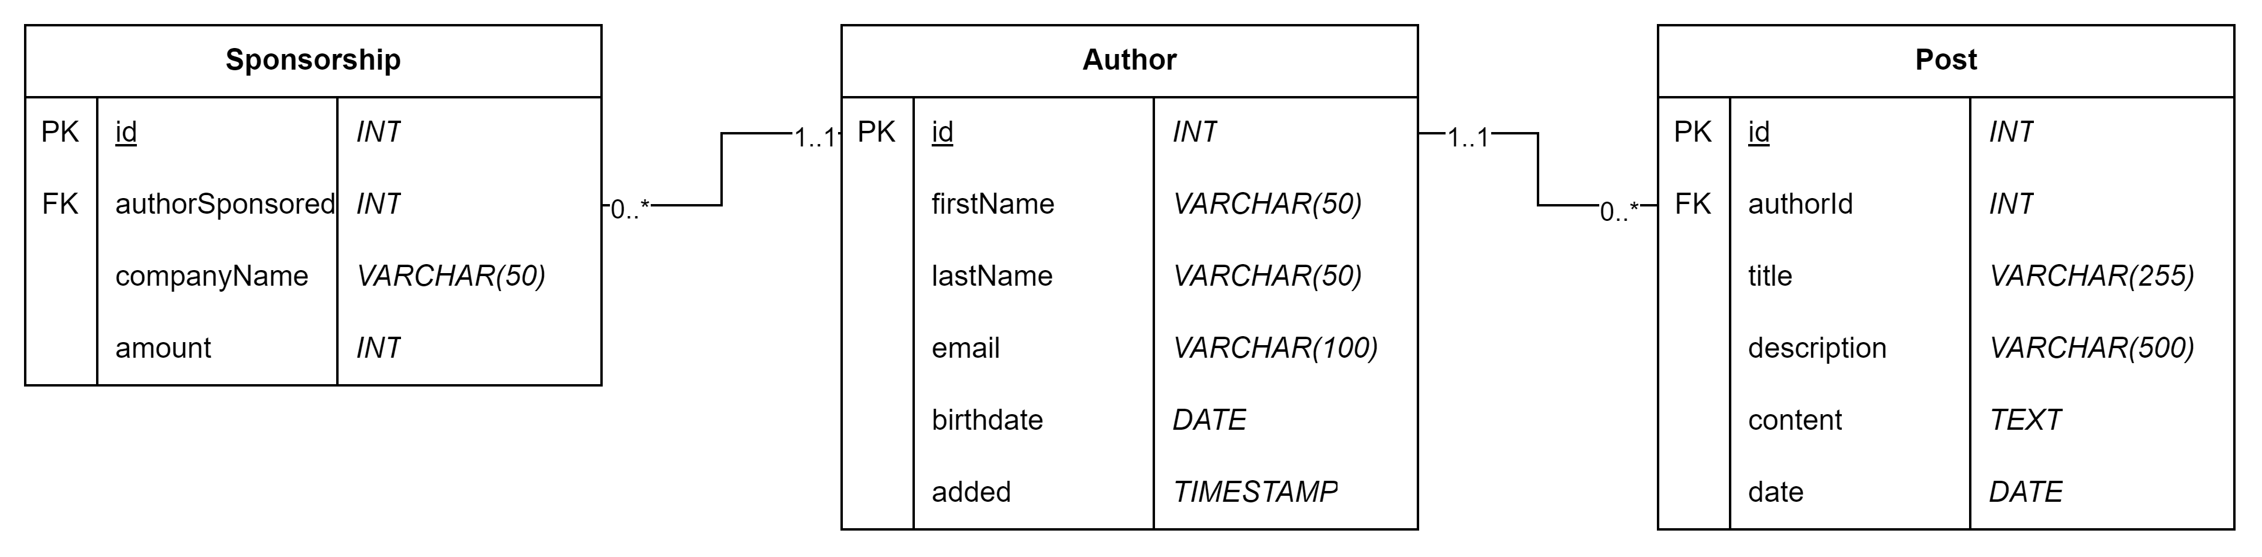
In Class Exercise
Download/import the blog.sql database
Solve the remaining queries in blog_joins.mysqlnotebook

